Slide 1
IMM120 – Feb 5
Using Variables

Slide 2
Previously in IMM120
Do if-statements activate code?
Are variables case sensitive?
How to code the eraser?

Slide 3
Previously in IMM120
Do if-statements activate code?
Are variables case sensitive?
How to code the eraser?
Notes:
4 of you slept well last week, I have little hope for this week.

Slide 4
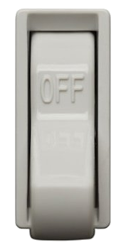
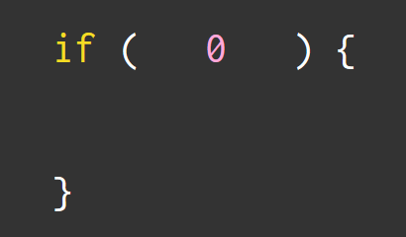


Slide 5
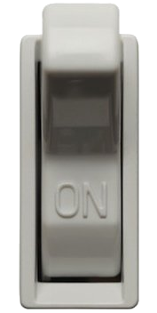


Slide 6
ellipse(100, 200, 300, 400);
This line is called a command.
ellipse is a function.
by using this function, we are calling it and sending it data.

Slide 7
Previously in IMM120
Do if-statements activate code?
Are variables case sensitive?
How to code the eraser?
mouseX != MOUSEX
mouseIsPressed / keyCode
Notes:
Remember this is called camel case
4 of you slept well last week, I have little hope for this week.

Slide 8
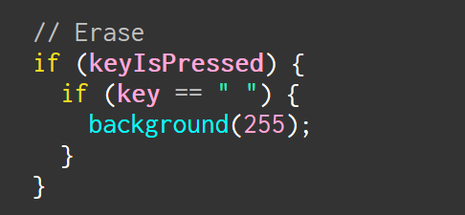
Previously in IMM120
Do if-statements activate code?
Are variables case sensitive?
How to code the eraser?

Slide 9
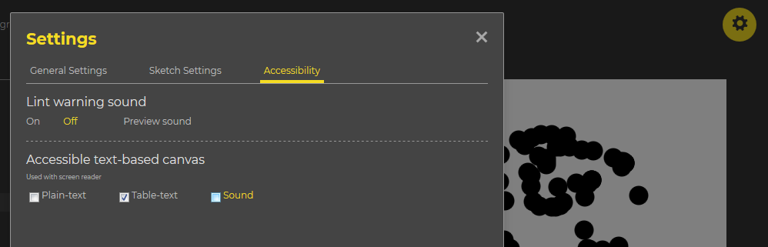
Sound Problems in the Editor

Slide 10
Today in IMM120
Making terrible Pong
Objects review
Making Terrible Pong really weird
Notes:
We’re going to talk about some of the most common ways to use variables.

Slide 11
https://pastebin.com/YByGz6Rh
A permenant Pastebin for the latest code

Slide 12
Making Things Move

Slide 13
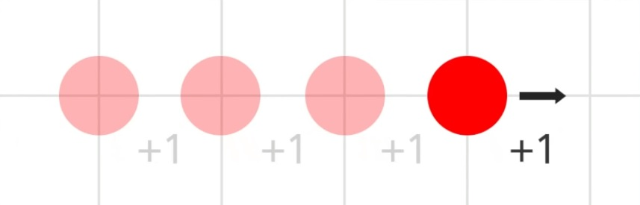

Slide 14
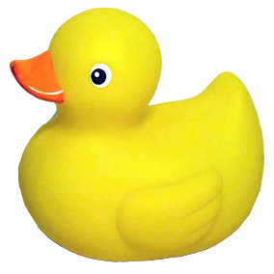
Pseudocode
Make variables for circle (position, speed)
Forever in draw:
Background
Draw the circle
Add speed to position
Notes:
640 for width

Slide 15
Pseudocode
Make variables for circle (position, speed)
Forever in draw:
Background
Draw the circle
Add speed to position
If we hit the bottom edge:
bounce

Slide 17
Pseudocode
Make variables for circle (position, speed)
Forever in draw:
Background
Draw the circle
Add speed to position
If we hit the bottom edge:
bounce

Slide 18
Pseudocode
Make variables for circle (position, speed)
Forever in draw:
Background
Draw the circle
Add speed to position
If we hit the bottom edge:
bounce
If we hit the right edge:
bounce

Slide 19
Pseudocode
Make variables for circle (position, speed)
Forever in draw:
Background
Draw the circle
Add speed to position
If we hit the bottom edge:
bounce
If we hit the right edge:
bounce
If we hit the top edge:
bounce
If we hit the left edge:
bounce
Notes:
Take a break?

Slide 20
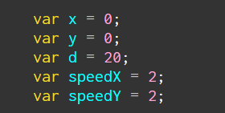
Objects, Take 2

Slide 21
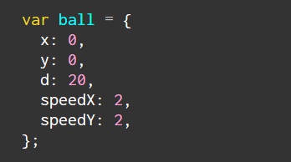
Objects, Take 2

Slide 22
Different Modes
Set a variable at the top: mode
Use if (mode == #) to change behavior in the code

Slide 23
Modes For Fun
Square instead of circle
Leave a trail behind you
Randomly change the size of the shape
Gravity

Slide 24
Gravity
position
speed

Slide 25
Gravity
position
speed
acceleration

Slide 26
Gravity
position
speed
acceleration

Slide 27
Gravity (a hint for future classes)
position
speed
acceleration
DERIVATIVES
INTEGRALS

Slide 28
Modes For Fun
Square instead of circle
Leave a trail behind you
Randomly change the size of the shape
Gravity

Slide 29
No Class Next Week
I will be in Denver, CO for a conference.
I will post a tutorial on how to add images to your sketches.

Slide 30
Homework
Mirror Drawing due next Monday

Slide 32
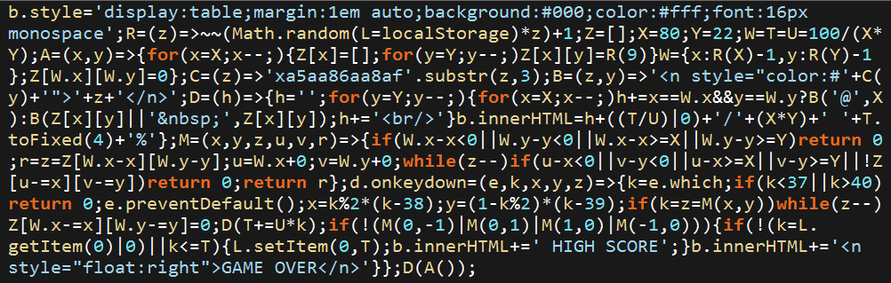
Notes:
1014 bytes

Slide 33
js1k
https://js1k.com
https://js1k.com/2017-magic/details/2824

Slide 34
Minute Survey
https://js1k.com
https://js1k.com/2017-magic/details/2824
Notes:
Next class: images, spritesheets, making memes

